Slide 1
SISTEM BUNYI BAHASA MELAYU
(MALAY SOUND SYSTEM)

Slide 2


MALAY ALPHABET
CAPITAL LETTER (HURUF BESAR)
A B C D E F G H I J K L M N O P
Q R S T U V W X Y Z
SMALL LETTER (HURUF KECIL)
a b c d e f g h I j k l m n o p
q r s t u v w x y z

Slide 3

Bunyi-bunyi Huruf
Vokal
Konsonan
Diftong (gabungan vokal)
Vokal Berganding
Diagraf (gabungan konsonan)
1

Slide 4
Bunyi-bunyi Huruf
VOWAL (HURUF VOKAL)
a e(pepet) e(taling) i o u
CONSONANT (HURUF KONSONAN)
b c d f g h j k l m n p
q r s t v w x y z

Slide 5
HURUF DIFTONG
ai – serai
au - aura
oi - amboi

Slide 6
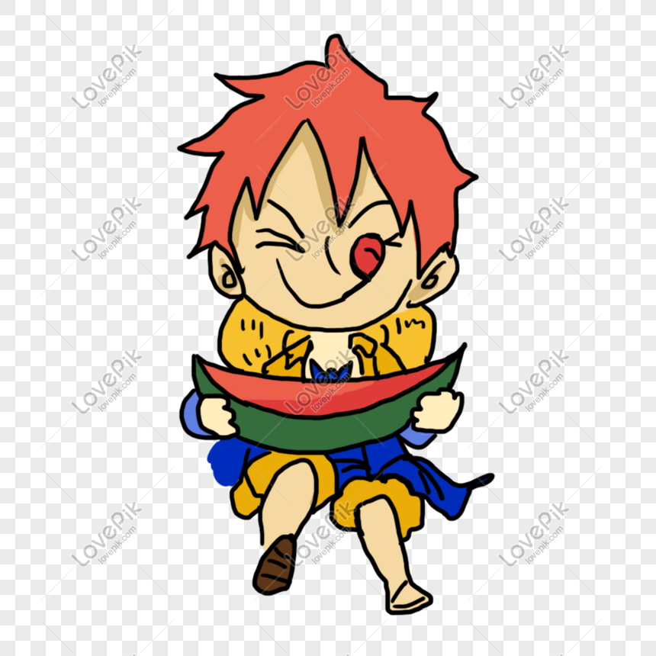
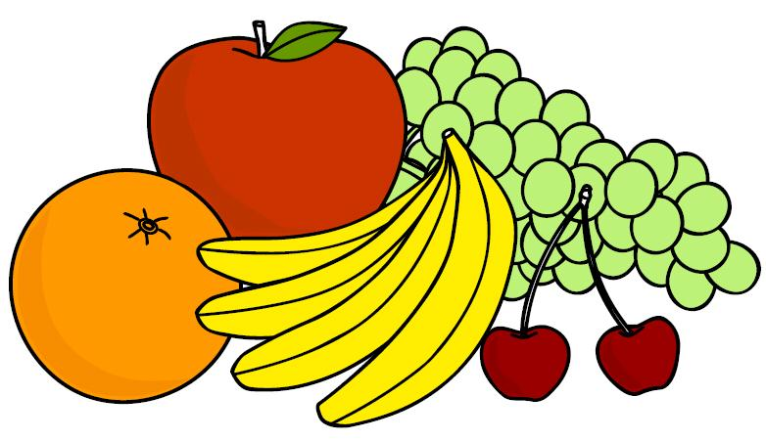
***VOKAL BERGANDING
io – biola
ua – buah
ia – dia
iu – siul

Slide 7
DIAGRAF ( GABUNGAN KONSONAN)
gh kh ng ny sy

Slide 8
BUNYI VOKAL
1. VOKAL A : Cara menyebutnya /a/ ( father )
Sebut suku kata berikut dengan betul
b a | c a | d a | f a | g a | h a | j a | k a | l a | m a
n a | p a | q a | r a | s a | t a | v a | w a | y a | z a
https://www.youtube.com/watch?v=yBnkt-TIlew

Slide 9
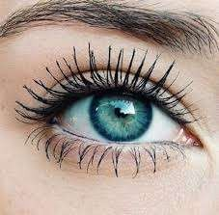
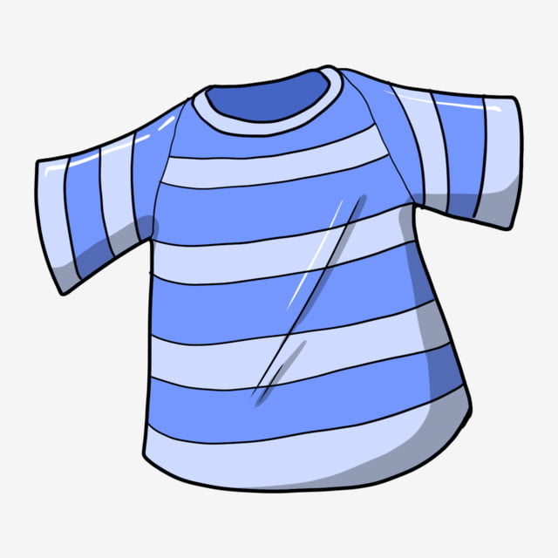
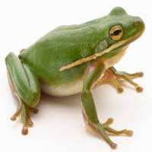
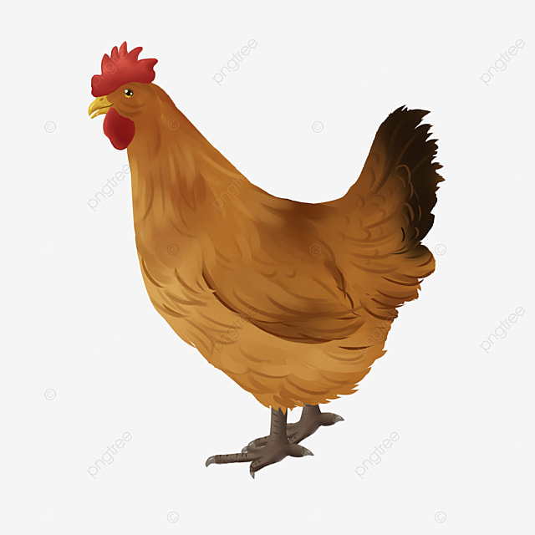
SEBUT PERKATAAN BERIKUT :
Mata
Baju
Katak
Ayam

Slide 10

***For letter A, the standard pronunciation is [aa], but while speaking, at the end of a word, it is casually pronounced very clear to E [er], if you notice the way Malay native speakers pronounced it
Examples;
Word Standard Casual
Saya sa[yaa] sa[yer]
Apa a[paa] a[per]
Mana ma[naa] ma[ner]
2

Slide 11
2. VOKAL E : CARA MENYEBUTNYA (again)
*** IN MALAY LANGUAGE, LETTER ‘E’ HAS TWO DIFFERENT PRONUNCIATION.
Sebut suku kata berikut dengan betul :
b e | c e | d e | f e | g e | h e | j e | k e
l e | m e | n e | p e | r e | s e | t e
https://www.youtube.com/watch?v=ReUAb-ZfeU0&t=14s

Slide 12

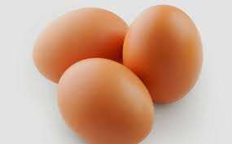

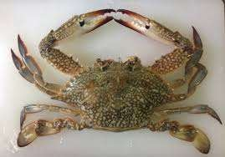



Ketam
Telur
Enam
Empat

Slide 13
3. VOKAL E : CARA MENYEBUTNYA /Ě/ ( apple )
Sebut suku kata berikut dengan betul :
b ě | c ě | d ě | f ě | g ě | h ě | J ě | k ě
l ě | m ě | n ě | p ě | r ě | s ě | t ě | w ě
https://www.youtube.com/watch?v=TjI0i0KazMQ

Slide 14


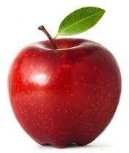
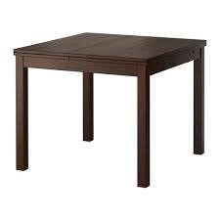

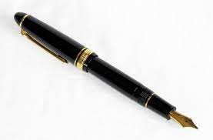

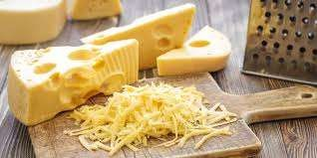
ĔPAL
Mĕja
Pĕn
Kĕju

Slide 15
HOMONIM
(SAME SPELLING BUT DIFFERENT PRONUNCIATION AND MEANING)
Contoh :
  sepak (slap) sepak (kick)
  perang (war) perang (brown)
  semak (bush) semak (check)
  bela (breed) bela (defence)
*** you cannot identify which pronunciation to use whether [eh] or [Eer] unless you know the word itself.
However e pronunciation matters whether it is [eh] or [eer], as it determines the meaning of certain words.

Slide 16
4. Vokal I : Cara menyebutnya /ee/ ( feet , neat )
Sebut suku kata berikut dengan betul :
b i | c i | d i | f i | g i | h i | j i | k i | l i | m i
n i | p i | q i | r i | s i | t i | v i | w i | y i | z i
https://www.youtube.com/watch?v=6U60RM5T1U0

Slide 17


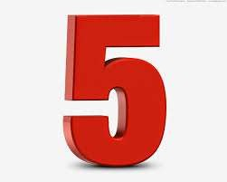
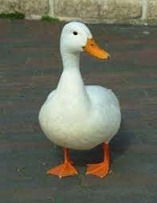


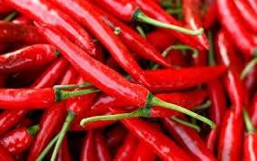
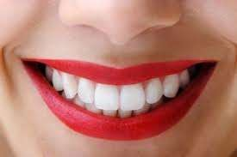
Itik
lima
cili
gigi

Slide 18
***For the letter I, the standard pronunciation is [ee], but while speaking, at the middle of the end of the syllable, it is pronounced very near to E [eh]
Here is an example and look at the difference
  Word Standard Casual
  Putih pu[teeh] pu[teh]
  Kuih ku[eeh] ku[eh]

Slide 19
5. Vokal O : Cara menyebutnya /o/ ( note )
Sebut suku kata berikut dengan betul :
b o | c o | d o | f o | g o | h o | j o | k o | l o
m o | n o | p o | r o | s o | t o | v o | y o | z o
https://www.youtube.com/watch?v=8PaFDsdqFeY

Slide 20



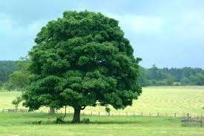

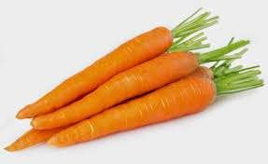

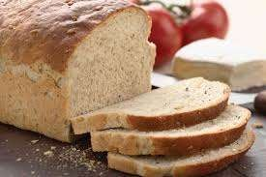
Po- kok
Bo-la
Lo- bak
Ro- ti

Slide 21
6. Vokal U : Cara menyebutnya /uu / ( food )
Sebut suku kata berikut dengan betul :
B u | C u | D u | F u | G u | H u | J u | K u | L u | M u
N u | P u | Q u | R u | S u | T u | W u | Y u | Z u
https://www.youtube.com/watch?v=-FhHNdoWHk4

Slide 22

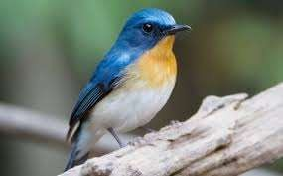
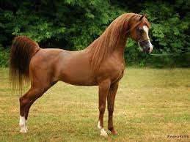
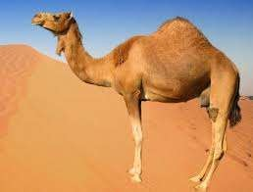
burung
ubat
kuda
unta

Slide 23
***For letter U, the standard pronunciation is [uu], but while speaking, at the middle of the end of the syllable, it is pronounced very near to O [o].
Here is an example and look at the difference
  Word Standard Casual
  puluh pu[looh] pu[loh]
  ketuk ke[took] ke[tok]

Slide 24
How To Form Word and Sentence
Konsonan (K) + Vokal (V) = Suku kata (Syllable)
Vokal (V) + Konsonan (K) = Suku kata (Syllable)
Suku kata + Suku kata = Perkataan/Kata (Word)
Perkataan + Perkataan = Ayat (Sentence)

Slide 25
Variation of Syllable in Malay Language
Example of the Malay words
One syllable - jam (clock/watch)
Two syllable - muka (face)
Tree syllable - kereta (car)
Four syllable - keluarga (family)
More than four syllable - warganegara (citizen)

Slide 26
Variation of Syllable in Malay Language
LEBIH DARI EMPAT SUKU KATA
(More Than Four Syllable Words)
Contoh (Example):
universiti (university)
malapetaka (disaster)
setiausaha (secretary)
warganegara (citizen)
kosmopolitan (cosmopolitan)

Slide 27
MALAY ALPHABET
A- ayam - chicken
B- bola - ball
C- cawan - cup
D- dadu - dice
E- emak - mother
E- ekor - tail
F- feri - ferry
G- gajah - elephant
H- helang - eagle
I- itik - duck
J- jari - finger
K- kaki - foot/leg
L- lari - run
M- makan - eat

Slide 28
MALAY ALPHABET
N- nasi - rice
O- oren - orange
P- pagi - morning
Q- quran - quran
R- rasa - taste
S- saya - I/me
T- telur - egg
U- udang - shrimp
V- van - van
W- wayang - movies
X- x-ray - x-ray
Y- yatim - orphan
Z- ziarah - visit

Slide 29
TERIMA KASIH

